Slide 1
Big Data Architecture and Governance
Individual Project | Tesla
Aaradhy Sharma

Slide 2
1. Selection Assignment

Slide 3
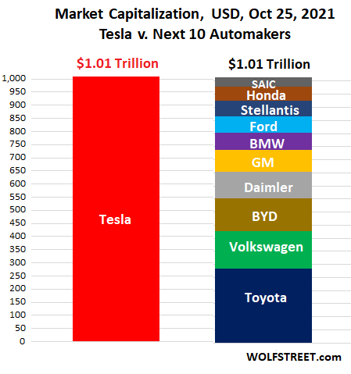
Tesla
Industry: Automotive, and energy generation and Storage
History/Background:
Tesla initially known as Tesla Motors was founded in 2003 by Martin Eberhard and Marc Trepanning in San Carlos.
The name tesla comes after a Genius Inventor Nikola Tesla who is known for his discoveries and invention in the field of electricity
Elon Musk join Tesla in 2004 and has become head of the chairman.
Tesla currently has the highest market cap of all car manufacturer

Slide 4
Issue Name: Improving Quality Assurance
Tesla Currently facing Quality Assurance issues with the production of its cars such as model 3, Model X, Model Y, and new Model S Plaid
With the Help of Big data this process can be streamlined.
Such as real-time monitoring of cars like how often service requires maintenance downtime, software update, issues, etc.
Doing predictive analysis: for example, Tesla is manufacturing its own chipset using predictive analysis several checks can be avoided.

Slide 5
Impact Statement Guide
The purpose of this project is to improve Tesla Quality Assurance and help in keeping up with future demand

Slide 6
Issue Name: Battery Lifecycle Optimization
Along with Car manufacturing Tesla is also Dealing with Battery manufacturing and energy Storge as well Installing there Charging plant In the US, Eu, and China
Currently there is a big issue with battery Life as over a long period of time battery life is said to deteriorate
Using Big Data, we can predict battery deterioration get data from users on its usage. And improve the overall lifecycle.

Slide 7
Impact Statement Guide
The purpose of this project is to improve the overall battery lifecycle of all tesla cars and other products.

Slide 8
2. Company SWOT Analysis

Slide 9
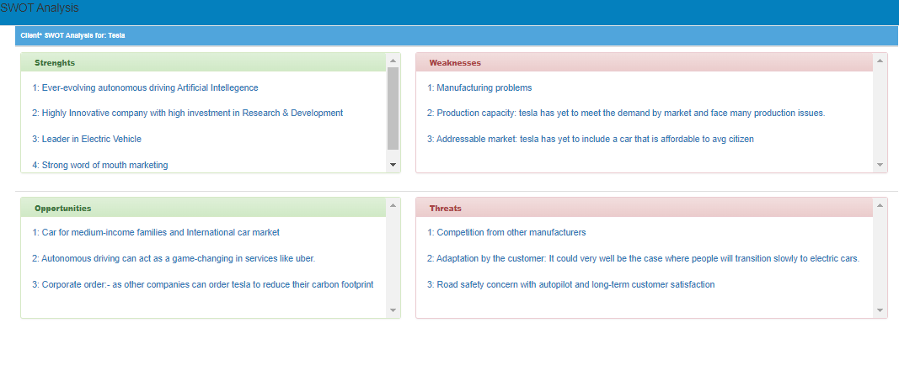
Company Name: Tesla

Slide 10
3. Project Mandate

Slide 11
Project Mandate
Project Name: Improving Quality Assurance Page 1/2
Project Overview
Tesla Currently facing Quality Assurance issues with the production of its cars such as model 3, Model X, Model Y, and new Model S Plaid With the help of Big data Net time required in quality assurance can be decreased on callbacks of cars for minor faults can be reduced or several other faults can be detected in existing cars.
Business Issues/ Opportunities
Current customer has issue with quality of newest of model
Vehicle manufacturing time
Project Objectives
Decrease the time used in Quality assurance for Tesla Cars
Reduce Number of callbacks for car due to minor issue
Develop a robust data network system to monitor vehicle performance so early callbacks or batch callbacks can be performed

Slide 12
Project Mandate
Project Name: Improving Quality Assurance Page 2/2
Scope
The project will improve Quality assurance and improve the overall product lifecycle of Tesla cars. The dependencies would be to gather data points and The current manufacturing process.
Constraints
Some of the constraints that can happen to a project are time demands. Initial lack of data points cost to benefit ratio
Interfaces
The project will interface with several other projects such as the Tesla customer feedback network, manufacturing department Research and development team, Service department,
Customers And Users
The main Beneficiary of this Projects would be Quality Assurance Team, CTO, Chief Manufacturing Officer, Manufacturing Team, New Customer, Pre-Existing customer

Slide 13
Project Mandate
Project Name: Battery Life Cycle optimization Page 1/2
Project Overview
Tesla is in the business of Battery manufacturing and energy Storge as well Installing their Charging plant In the US, Eu, and China. Currently, there is a big issue with battery Life as over a long period of time battery life is said to deteriorate Using Big Data, we can predict battery deterioration get data from users on its usage. And improve the overall Battery lifecycle.
Business Issues/ Opportunities
Battery Drainage issue
Optimal Battery charging issue
Improving current charging infrastructure according to data
Extending overall battery life
Project Objectives
Gather data from users on there battery usage
Get estimate on when battery quality Deteriorate
Using big data to fin ideal charging way

Slide 14
Project Mandate
Project Name: Battery Life Cycle optimization Page 2/2
Scope
The scope of this project would be a Deliver project that can accurately predict battery life. And its deterioration time is based on usage by data such as its charging time.
Constraints
The product can have constraints such as cost to benefit ratio. The innovation in battery tech such as sodium ion could be a constrain for this project.
Interfaces
The project will interact with other products such as the customer feedback department, Research, and Development and Onboard software, and Sensors
Customers And Users
The current tesla owner would be an existing customer, as well as a charging station owner.

Slide 15
4. Vision Diagrams

Slide 16
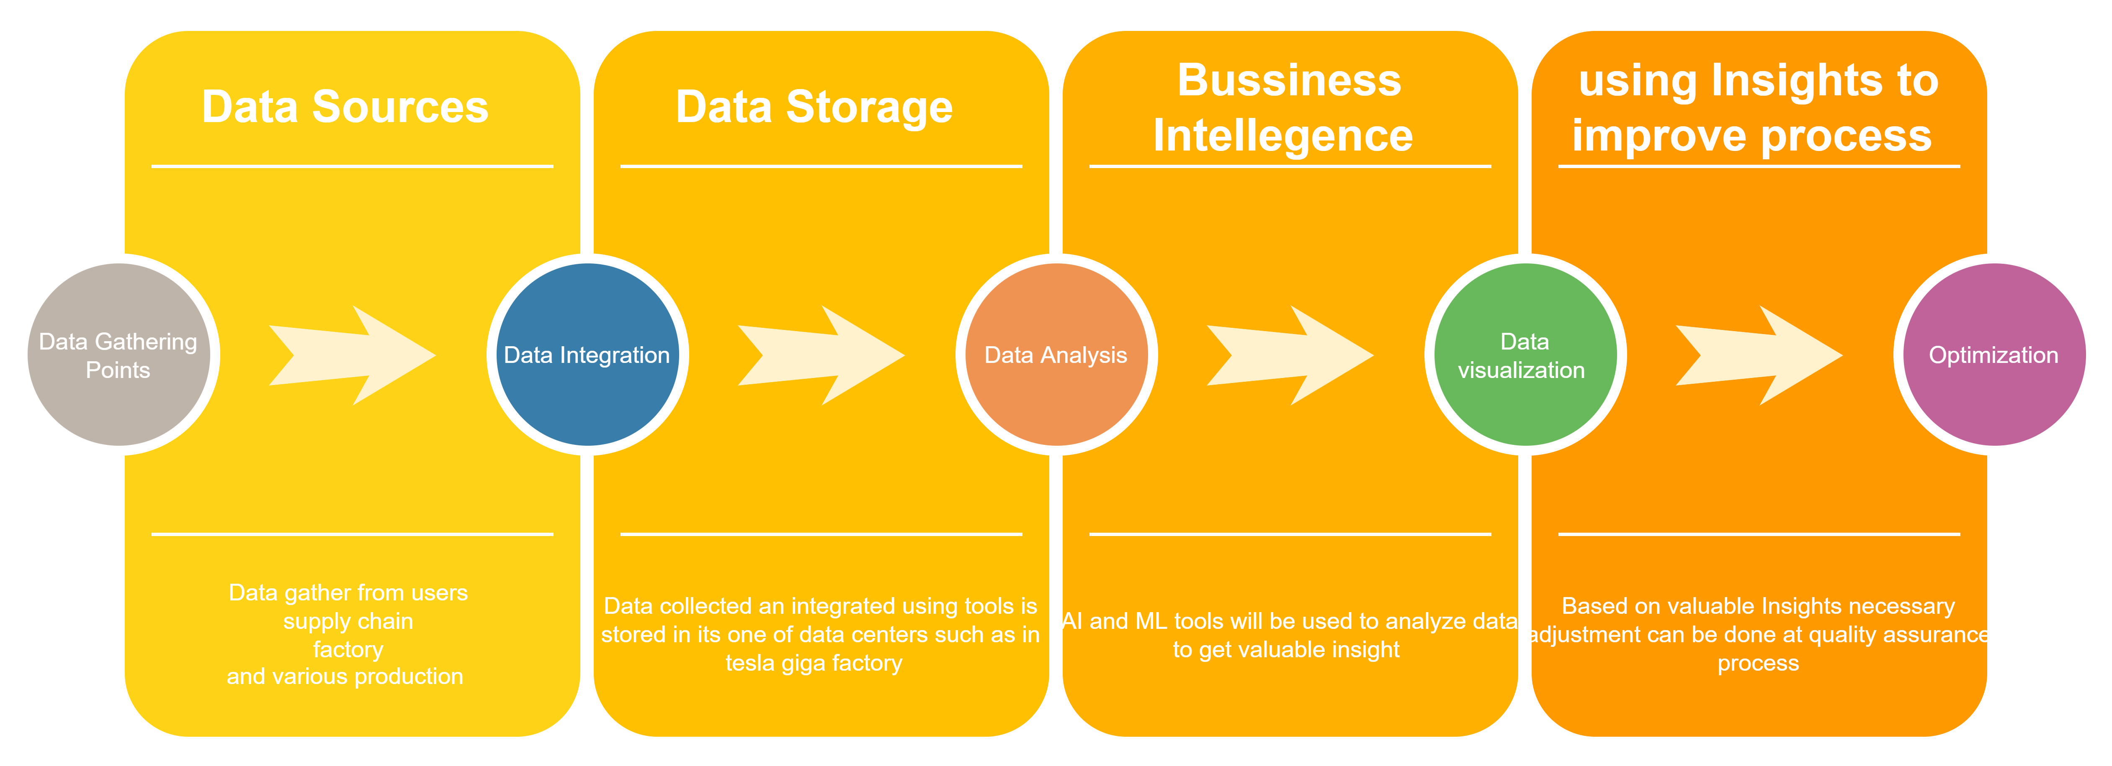
Vision Diagram: Improving Quality Assurance

Slide 17
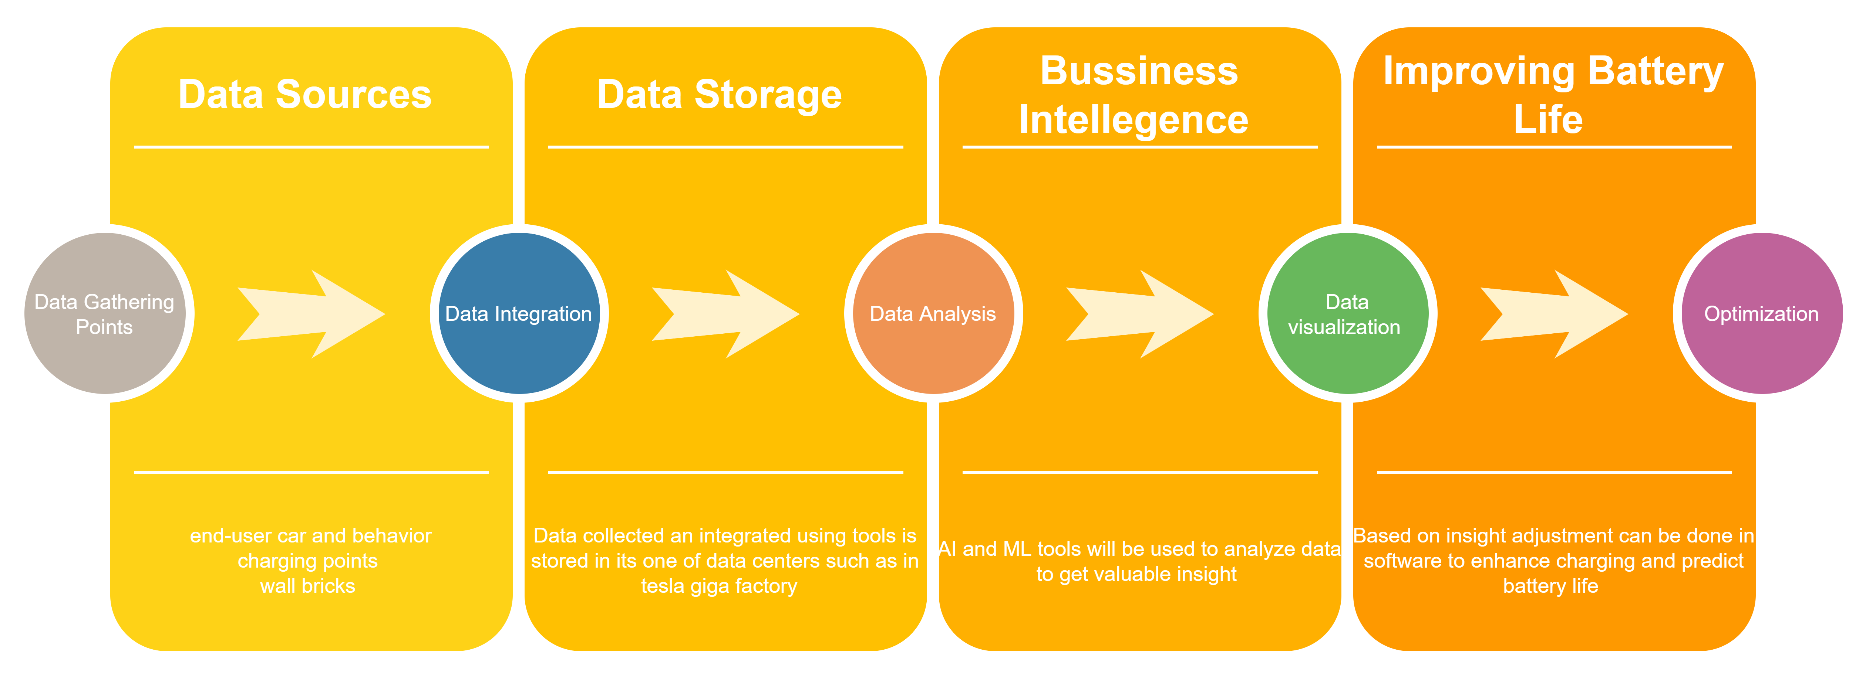
Vision Diagram: Battery lifecycle optimization

Slide 18
5. Project Detail

Slide 19
Project Name: Battery Optimization

Slide 20
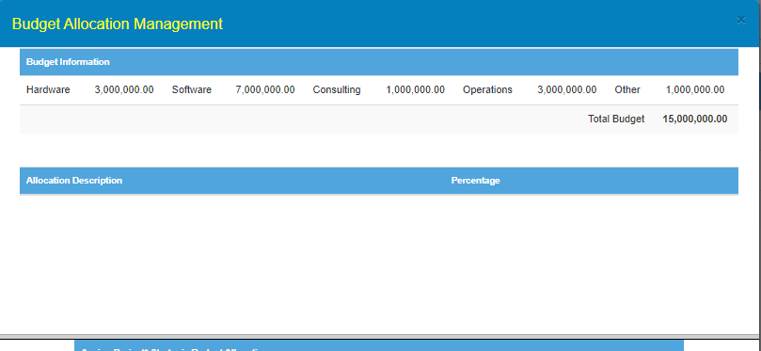
Project Budget

Slide 21
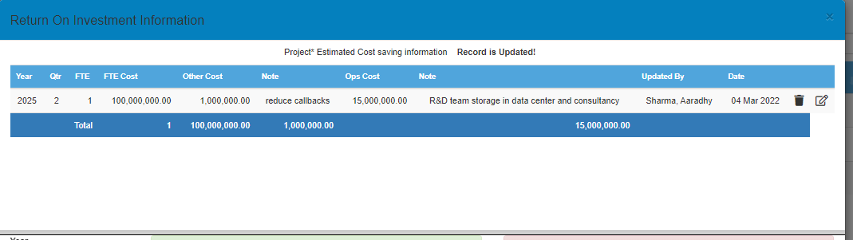
ROI

Slide 22
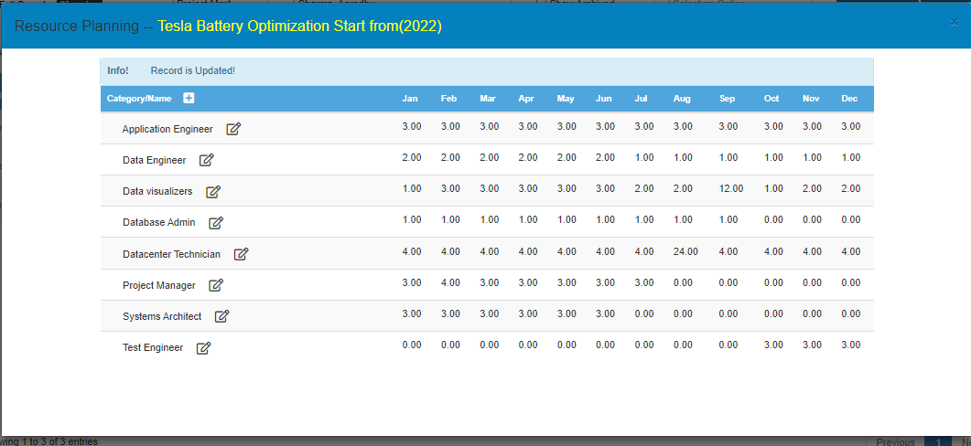
Required Resources

Slide 23
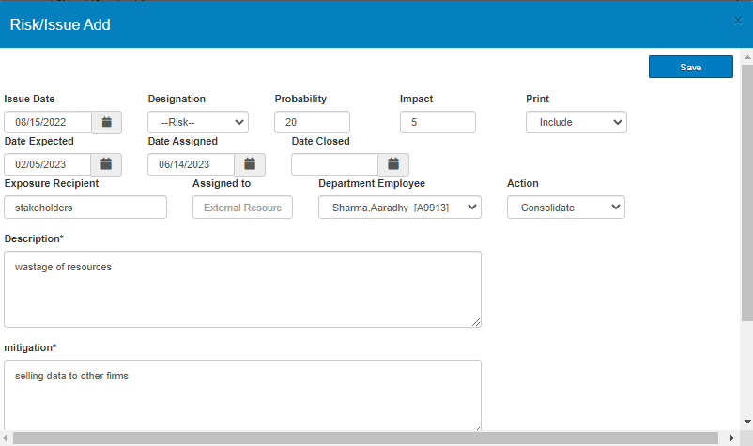
Risk

Slide 24
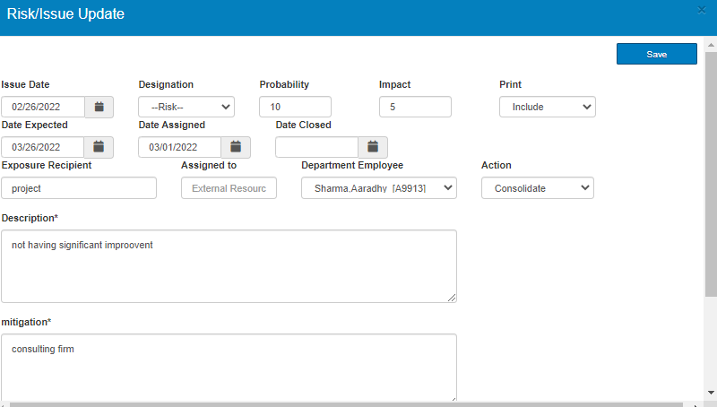
Risk

Slide 25
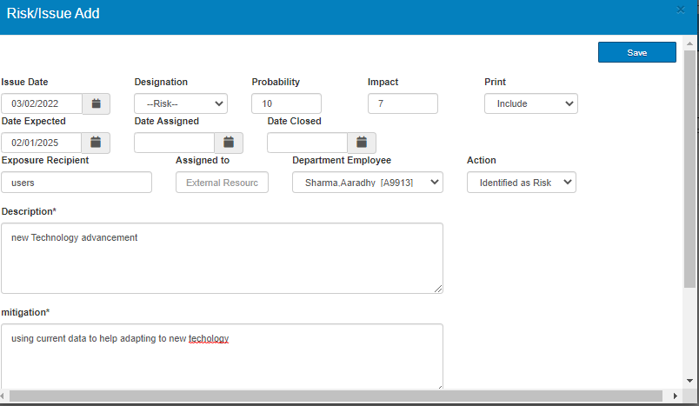
Risk

Slide 26
SWOT
The Battery optimization can make tesla mainstream by increasing customer trust towards product plus addressing the concern of lithium-ion battery losing its efficiency overtime.

Slide 27
Project Name: Improving Quality assurance

Slide 28
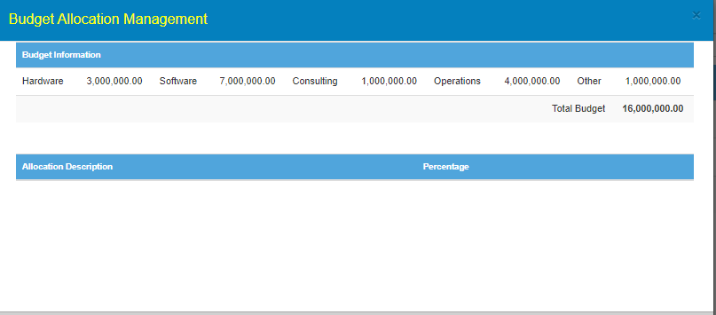
Project Budget

Slide 29
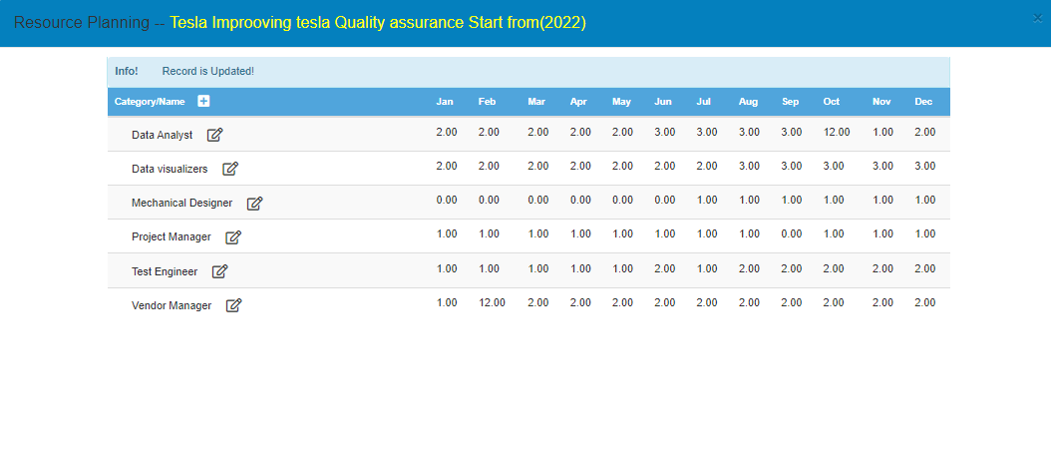
Required Resources

Slide 30
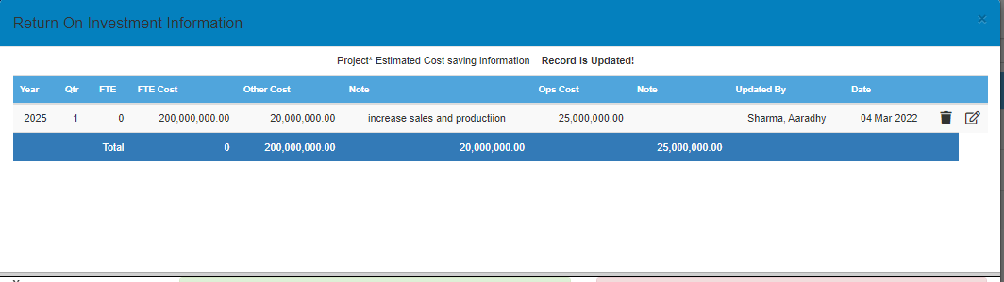
ROI

Slide 31
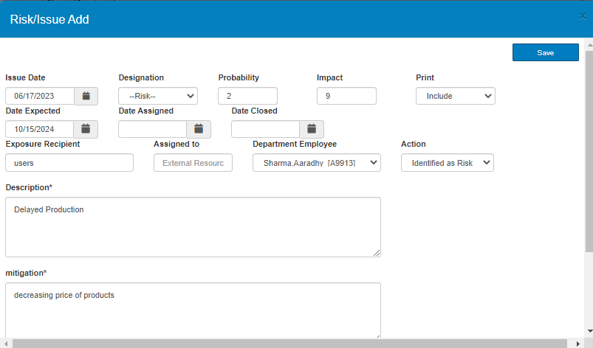
Risk

Slide 32
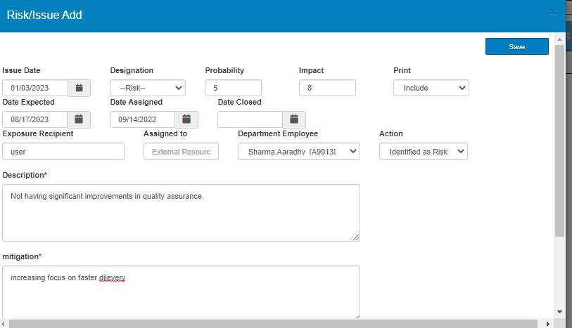
Risk

Slide 33

Risk

Slide 34
SWOT
This Project can potentially reduce large no. of callbacks and other production issues, which can increase sales and reduce production time.

Slide 35
6. Selection Logic

Slide 36
Project Selection: Improving Quality Assurance
Moving forward with Improving Quality Assurance as it has lots of room for improvement considering the current scenario of recalls done by tesla as well as improving customer satisfaction and will decrease cost maintenance to the customer as well.

